Slide 1
LEGEND-1000 and
Particle and Nuclear Physics Synergies
D.C. Radford
LEGEND-UK 31 March 2022

Slide 2
Outline
The LEGEND-1000 project
  An overview of the LEGEND-1000 experiment
  The project; total funding and effort required
  DOE component
  Non-DOE component
  Opportunities
Synergies
  Novel HPGe detectors
  Detector physics and high-precision pulse-shape simulations
  Digital pulse-shape analysis
  Gamma-ray tracking (AGATA/GRETA)
  Low thresholds: Dark Matter and CEvNS

Slide 3
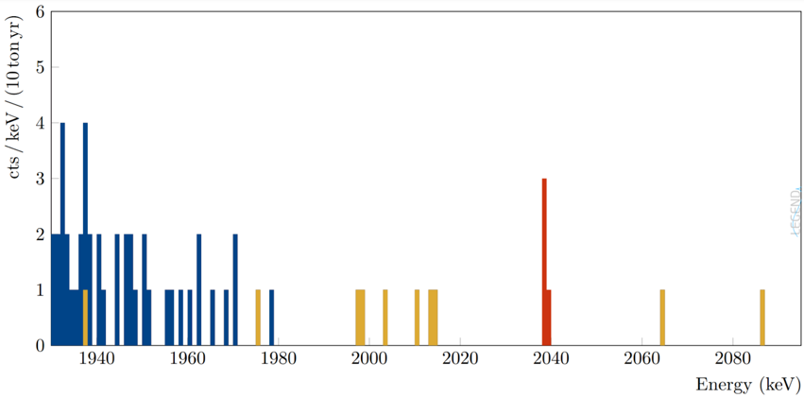
The LEGEND-1000 Discovery Sensitivity
“The collaboration aims to develop a phased, ⁷⁶Ge-based double-beta decay experimental program with discovery potential at a half-life beyond 10²⁸ years...”
What is required for a discovery of 0νββ decay at a half-life of 10²⁸ years?
This is less than one decay per year per ton of material
  Need 10 ton-years of data to get a few counts
  Need a good signal-to-background ratio
  to get statistical significance
    A very low background event rate
    The best possible energy resolution
Simulated example spectrum, after cuts,
from 10 years of data
Counts per keV
0νββ (T_{1/2} = 10²⁸ yr)
Energy (keV)

Slide 4
The LEGEND-1000 Experiment: Overview
1000 kg of enriched Ge detectors (92% ⁷⁶Ge)
2.6 kg average mass
Mounted in “strings” using components
made from electro-formed Cu and
scintillating plastic, PEN
Underground-sourced LAr active shield
Dual fiber-curtain LAr instrumentation
EFCu Reentrant tubes
Arranged in 4 modules
~100 detectors per module
Notes:
4 reentrant tubes, 250 kg each array, 14 strings with 7 detectors, each 2.5 kg,

Slide 5
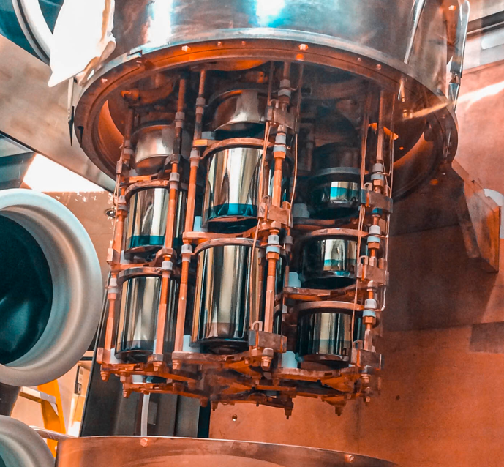
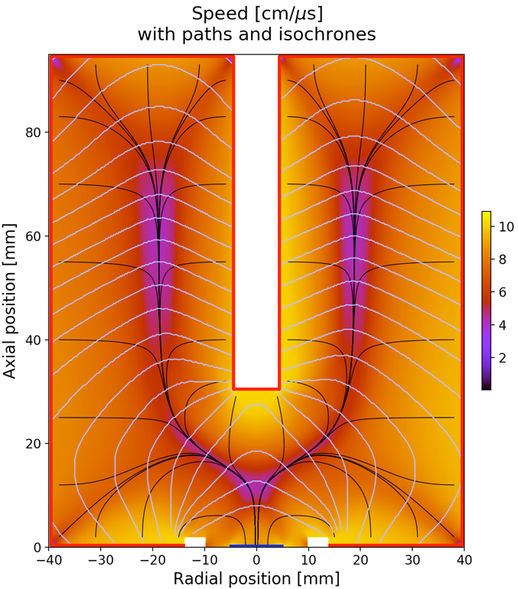
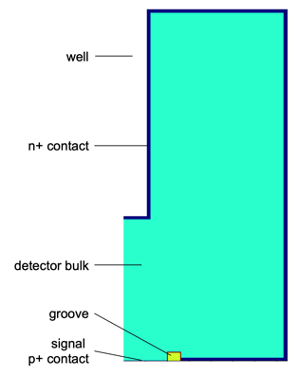
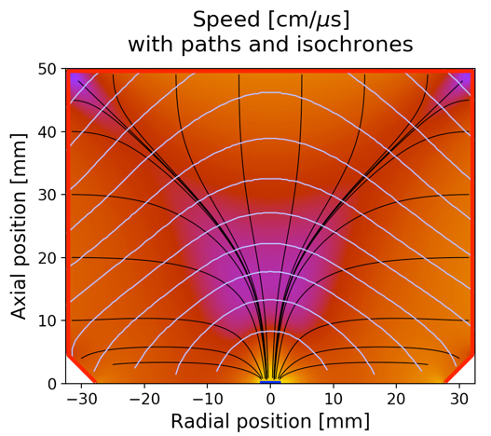
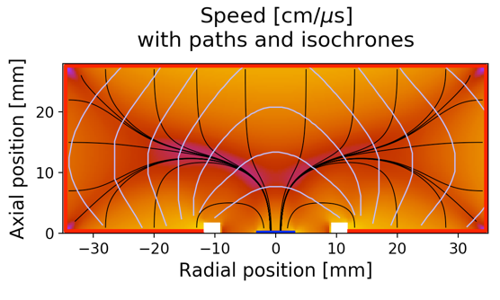
Innovation toward LEGEND-1000: ^{enr}Ge Detectors
Superb energy resolution: σ / Q_{ββ} = 0.05 %
P-type detectors: Insensitive to alphas on n⁺ outer contact
Pulse-shape discrimination against background events
Large-mass ICPC detectors: About 4 times lower backgrounds compared to BEGes / PPCs
Proven long-term stable operation in LAr
LEGEND (ICPC)
well
Majorana (PPC)
GERDA (BEGe)
n⁺ contact
bulk (p-type)
groove
p+ contact
Notes:
Spell out ICPC. The three detector geometries developed by the Majorana, GERDA, and LEGEND collaborations. The mass of ICPC detectors is up to a factor 3 larger than that of its predecessors.

Slide 6
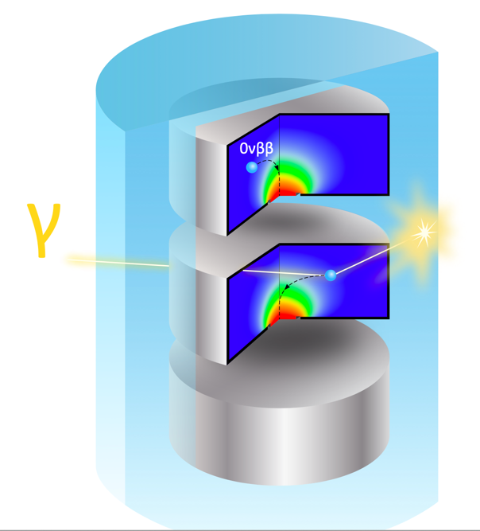
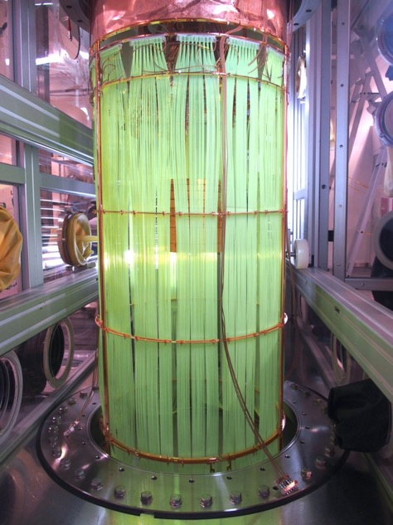
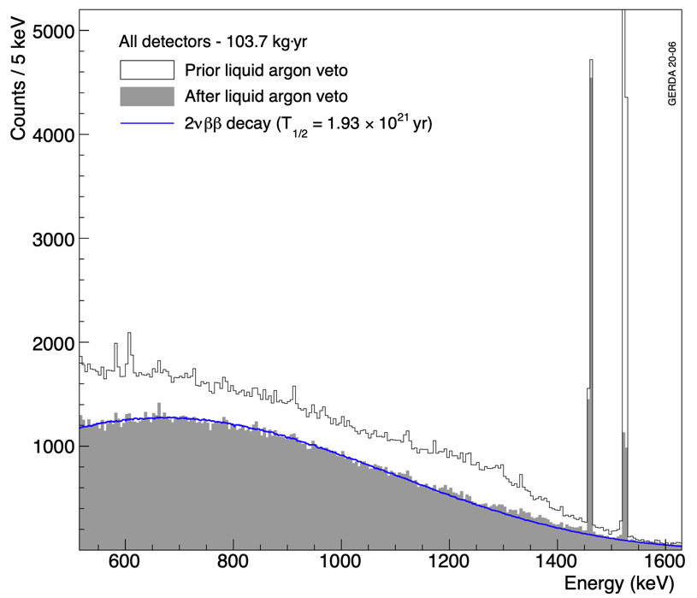
Innovation toward LEGEND-1000: LAr Instrumentation
Gerda: Detection of liquid argon scintillation light to reject background events
(Like a giant anti-Compton shield)
Low-background wavelength-shifting fibers and SiPM arrays for 128 nm single photon detection
Prior to liquid argon veto
Compton events with energy deposition in the LAr
Pure 2νββ spectrum after LAr signal suppression
Figure 4, page 14

Slide 7
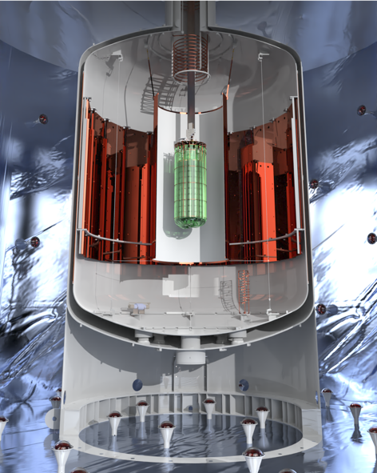
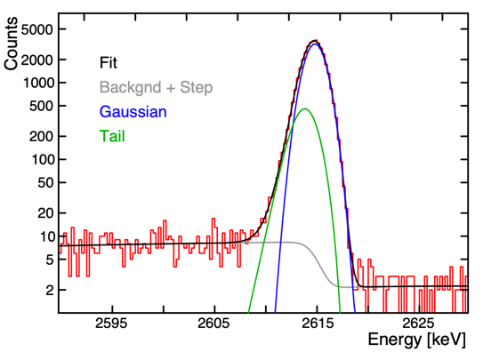
Innovation toward LEGEND-1000: LEGEND-200
First phase of the LEGEND program, located at Gran Sasso (LNGS)
Re-uses the Gerda cryostat and infrastructure
Improved LAr readout system
About 135 kg of novel ICPC detectors (92% enr. ⁷⁶Ge) plus 62 kg of PPC and BEGe detectors
Low-background materials
Sensitivity goal: 10²⁷ years
Commissioning now
ICPC peak shape
Notes:
Excellent response / peak shape. Mean energy resolution of 2.2 keV FWHM is significantly below our goal of 2.5 keV

Slide 8
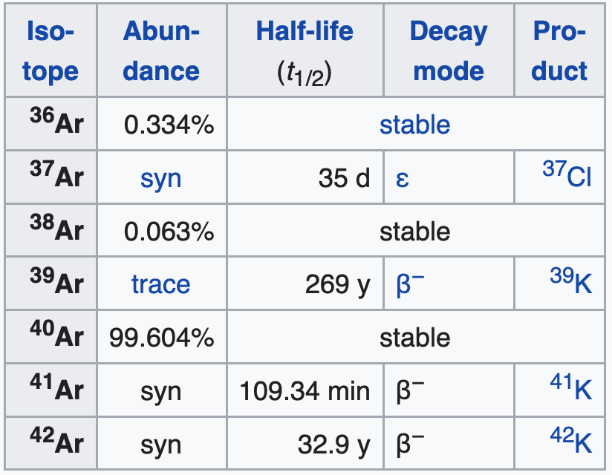
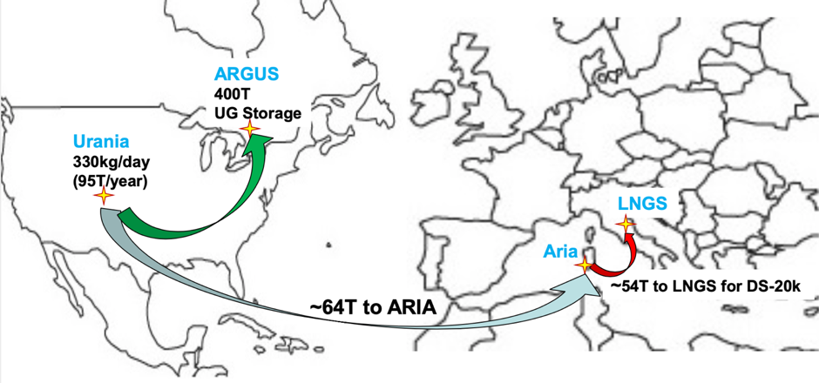
The Baseline Design: Underground Liquid Argon
L1000 needs 20-25 t of UGLAr
Builds on pioneering work of DarkSide collaboration
UGAr will be mined at Urania facility (U.S.) 95 t/y
Logistics and storage technology under development by DarkSide/ARGO collaboration for LNGS and SNOLAB
Expression of interest from INFN president¹ and DarkSide leadership
UGAr production for LEGEND-1000 in 2023 (after DS-20k)
UGAr is depleted in ⁴²Ar (³⁹Ar)
Credit: DarkSide / ARGO collaboration
¹ “ …we are confident that the production of the required UAr can be completed in a time scale useful for the accomplishment of the LEGEND-1000 experiment.. The present statement is an expression of interest and availability from INFN…”
Notes:
(18.5t in reentrant tubes)

Slide 9
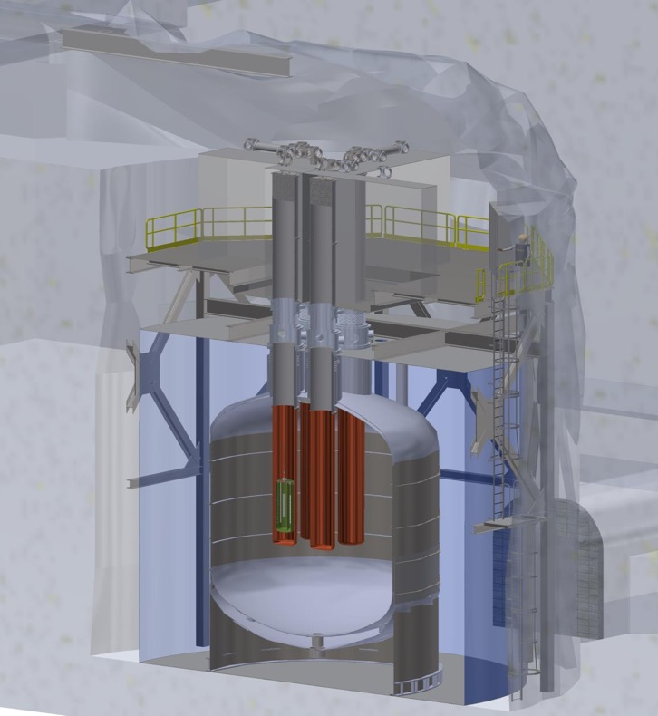
LEGEND-1000 Baseline Design: Underground Site
A deep-underground site is needed to shield the experiment from backgrounds generated by cosmic rays
Baseline site: The SNOLAB “Cryopit”
  2 km underground (6000m water equivalent)
  In an active nickel mine in Sudbury, Ontario
  Vertical access through mine shaft
Alternative site: LNGS (Italy)
  3500m water equivalent depth
  Lower overburden somewhat increases background
  Horizontal access reduces cost/schedule risk
Staff at both sites are actively involved in planning
We are currently assuming that we need to carry both sites forward through CD-1
Lock System
Work deck & glove boxes
Isolation valves
Re-entrant tubes
(UGLAr)
7m cryostat
12m water tank
15m cavity
LEGEND-1000 at SNOLAB

Slide 10
The Project
What is needed to build LEGEND-1000?
And how will we find the funding?

Slide 11
NSAC Long-Range Plan 2015
The excess of matter over antimatter in the universe is one of the most compelling mysteries in all of science. The observation of neutrinoless double beta decay in nuclei would immediately demonstrate that neutrinos are their own antiparticles and would have profound implications for our understanding of the matter-antimatter mystery.
We recommend the timely development and deployment of a U.S.-led ton-scale neutrinoless double beta decay experiment.

Slide 12
The Portfolio Review
The U.S. DOE Office of Nuclear Physics has adopted as part of its mission the building of a ton-scale neutrinoless double beta decay experiment.
Timeline:
  April 2016: LEGEND Collaboration formed
  Nov 2018: Approval of generic ton-scale CD-0 (“Mission Need”)
  Dec 2019: ORNL selected as U.S. Lead Lab for LEGEND
  Nov 2020: DOE-NP announces a “DBD portfolio review exercise … to inform U.S. investment strategy”
  18 April 2021: DOE instructions and charge received
  1 June 2021: Proposal submitted to DOE-NP
  13-16 July 2021: DOE-NP Portfolio Review of three experiments: LEGEND-1000, nEXO, CUPID
LEGEND performed exceedingly well, and emerged as the unambiguous leader
  DOE-NP has however stated that all three experiments were found to be worthy of support, and they would like to support a “DBD programmatic effort” if sufficient funding can be made available
LEGEND-1000 is now being supported by DOE-NP to proceed to the next step, “CD-1”,
as a “DOE Order 413.3b Project”

Slide 13
DOE Scope and Cost
New cost and schedule currently being developed
Total DOE cost point estimate at the portfolio review was $257M
  Includes 56% contingency
  Assumes technically driven funding profile
Anticipated DOE Project scope is approx. 60% of the total
  Where total scope estimate uses DOE accounting, fully burdened, escalated costs with 50% contingency
International collaborators intend to contribute the remaining 40%
Raw cost (unburdened procurements only) for that remaining scope is $51M

Slide 14
Notional Technically Driven Schedule
Calendar year
CD-1
CD-3
First Data
CD-4
CD-2/3a
Enriched Ge Production
Detector Production
Cryostat construction & Installation
1 2 3 4
Module Installation & Commissioning
Assumes technically driven funding profile
Key Dates:
  CD-1: Q4 FY22
  Module 1 Commissioning Complete: Q3 FY28 69 months (relative to CD-1)
  Early Finish: Module 4 Commissioning Complete: Q2 FY30 89 months
  Late Finish (36 months of float): Q2 FY33 125 months
Notes:
Key Dates & 36 Months of Float

Slide 15
LEGEND-1000 WBS (SNOLAB Option)
L-1
LEGEND 1000
L-1.01
Project Management
L-1.02
Simulations and Analysis
L-1.03
Materials and Assay
L-1.04
Host Lab Infr. and Cryostat Systems
L-1.05
Active Shielding
L-1.06
Ge Detector Production
L-1.07
Electronics and DAQ
L-1.08
Assembly/Install’n & Commissioning
L-1.01.01
International Project Office
L-1.02.01
Analysis Framework
L-1.03.01
Material Screening
L-1.04.01
Host Lab Infrastructure
L-1.05.01
Atmospheric Liquid Ar
L-1.06.01
Enriched Ge Production & Proc
L-1.07.01
Ge Front-End Electronics
L-1.08.01
Lab Infrastructure and Cryostat
L-1.01.02
US Project Office
L-1.02.02
Analysis Routines
L-1.03.02
Copper Electro-forming
L-1.04.02
Cryostat
L-1.05.02
Underground Liquid Ar
L-1.06.02
Detector Production
L-1.07.02
SiPM Front-End Electronics
L-1.08.02
Module 1
L-1.01.03
US WBS L2 & L3 Managers
L-1.02.03
Simulations
L-1.03.03
Plastics and Other Produced Mat’ls
L-1.04.03
Lock Systems and Interface
L-1.05.03
Liquid Ar Instrumentation
L-1.06.03
Detector Units
L-1.07.03
Cables, Connectors, and Feedthroughs
L-1.08.03
Module 2
L-1.04.04
Water Tank
L-1.05.04
Water Tank Instrumentation
L-1.07.04
Other Electronics
L-1.08.04
Module 3
Research Program
DOE Project
L-1.04.05
Calibration Systems
L-1.07.05
DAQ and Slow Controls
L-1.08.05
Module 4
Non-DOE Project
Host UG Lab
L-1.07.06
Integrated Testing
DOE-SC 413.3b Scope is carefully chosen
Notes:
Work organized, well decomposed and complete comprehensive

Slide 16
LEGEND-1000 WBS (LNGS Option)
L-1
LEGEND 1000
L-1.01
Project Management
L-1.02
Simulations and Analysis
L-1.03
Materials and Assay
L-1.04
Host Lab Infr. and Cryostat Systems
L-1.05
Active Shielding
L-1.06
Ge Detector Production
L-1.07
Electronics and DAQ
L-1.08
Assembly/Install’n & Commissioning
L-1.01.01
International Project Office
L-1.02.01
Analysis Framework
L-1.03.01
Material Screening
L-1.04.01
Host Lab Infrastructure
L-1.05.01
Atmospheric Liquid Ar
L-1.06.01
Enriched Ge Production & Proc
L-1.07.01
Ge Front-End Electronics
L-1.08.01
Lab Infrastructure and Cryostat
L-1.01.02
US Project Office
L-1.02.02
Analysis Routines
L-1.03.02
Copper Electro-forming
L-1.04.02
Cryostat
L-1.05.02
Underground Liquid Ar
L-1.06.02
Detector Production
L-1.07.02
SiPM Front-End Electronics
L-1.08.02
Module 1
L-1.01.03
US WBS L2 & L3 Managers
L-1.02.03
Simulations
L-1.03.03
Plastics and Other Produced Mat’ls
L-1.04.03
Lock Systems and Interface
L-1.05.03
Liquid Ar Instrumentation
L-1.06.03
Detector Units
L-1.07.03
Cables, Connectors, and Feedthroughs
L-1.08.03
Module 2
L-1.04.04
Water Tank
L-1.05.04
Water Tank Instrumentation
L-1.07.04
Other Electronics
L-1.08.04
Module 3
Research Program
DOE Project
L-1.04.05
Calibration Systems
L-1.07.05
DAQ and Slow Controls
L-1.08.05
Module 4
Non-DOE Project
Host UG Lab
L-1.07.06
Integrated Testing
DOE-SC 413.3b Scope is carefully chosen
Notes:
Work organized, well decomposed and complete comprehensive

Slide 17
LEGEND-1000 Project Organization
International
DOE
Figures 43, 44; pages 92, 93

Slide 18
International Level-2 and Level-3 Task Leaders

Slide 19
LEGEND-1000 R&D
The construction and commissioning of LEGEND-200 is very useful R&D for LEGEND-1000
  Tests and validates many aspects of the LEGEND-1000 design
Some examples of other remaining R&D that we are currently pursuing or planning:
  Ultra-clean rolling and welding of copper for the reentrant tubes
    1 mm thick
    Copper is electroformed underground to prevent cosmogenic radioisotopes
  Contact-free 3D printing of clean plastic parts
    Ideally these would be scintillating plastics
  Encapsulation of the detectors
    To protect against ⁴²K decays should UGLAr be unavailable

Slide 20
UK Opportunities
The search for 0νββ decay is one of the most compelling and exciting challenges in all of contemporary physics
  The discovery of 0νββ decay would dramatically revise our foundational
  understanding of physics and the cosmos
We are convinced that LEGEND-1000 is the experiment best positioned to make an unambiguous discovery
There are many exciting opportunities for UK scientists to get involved and contribute to very interesting and manageable aspects of the experiment

